Slide 1

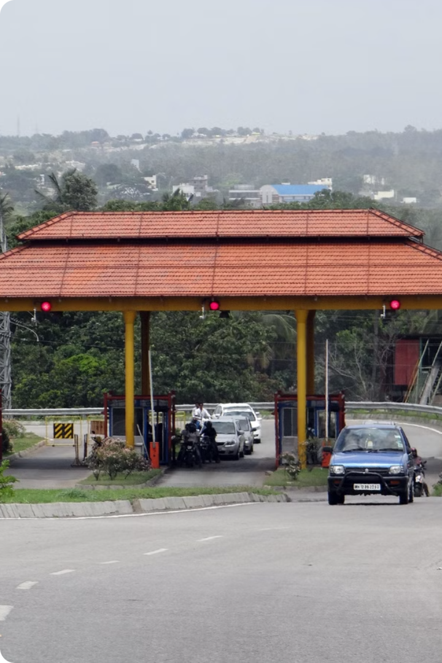
GPS Toll-Based System Simulation using Python
Aarupadai Veedu Institute of Technology
Name Satyam kumar
Reg No 3502110553 sirsatyamchaudhary@gmail.com

Slide 2

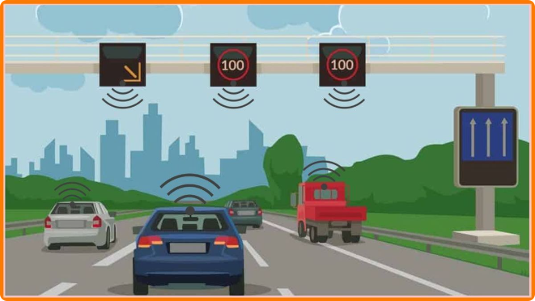
Introduction
Our project focuses on creating a robust and scalable simulation environment for a GPS toll-based system. This simulation will empower us to analyze the interactions between vehicles, toll zones, and payment mechanisms in a controlled environment.
1
The simulation accurately models the movement of vehicles
Taking into account factors like speed limits, traffic congestion, and route choices.
2
Tolls are dynamically calculated
Based on the distance traveled within toll zones, crossing fees, and time-dependent pricing adjustments.
3
The system incorporates diverse payment methods
Like online accounts, toll tags, and credit cards.
4
Comprehensive analytics are collected
On vehicle movements, toll revenue, and system performance to generate insightful reports.

Slide 3
Project Redefinition
This project aims to develop a comprehensive simulation incorporating realistic scenarios and features.
Geographic Scope
Vehicle Entry and Exit
Parallel Non-Toll Road
The simulation focuses on a 100km x 100km area defined by Google maps data.
The simulation includes realistic entry and exit points for vehicles.
The simulation incorporates a parallel non-toll road, providing an alternative route for vehicles.

Slide 4
Components of the Simulation
The GPS Toll-Based System Simulation is composed of several key components that work together to create a realistic and comprehensive model.
1
Vehicle Movement Simulation
Utilizing SimPy, the simulation accurately tracks vehicle movements in real-time. Vehicles are initialized with specific starting points, destinations, and speeds, ensuring realistic travel patterns.
2
Toll Zone Definition
Toll zones are defined using geospatial coordinates, allowing the system to accurately detect when vehicles enter or exit these zones. This enables precise toll calculations.
3
Distance Calculation
Based on the vehicle's GPS coordinates, the system calculates the distance traveled within each toll zone, ensuring accurate toll charges. Geospatial libraries like Shapely and GeoPandas are employed for these calculations.
4
Toll Calculation
Toll charges are dynamically calculated based on the distance traveled, fixed crossing fees, and variable pricing that can adjust based on congestion levels and time of day.
5
Payment Simulation
The simulation integrates various payment methods, including user accounts, toll tags, and credit cards, allowing for realistic deductions of toll charges and monitoring of user balances.

Slide 5
Use Cases
Our simulation can be applied in various use cases, providing valuable insights for traffic management, toll optimization, and infrastructure planning.
Realistic Area Simulation
Dynamic Pricing Implementation
Comprehensive Analytics
The simulation utilizes a defined geographical area, such as a 100km x 100km section from Google Maps, providing a realistic representation of a toll-based system.
The simulation gathers extensive data on vehicle movements, toll collection, and system performance, enabling the generation of detailed reports for performance analysis and informed decision-making.
Dynamic toll pricing can be tested and analyzed based on factors like congestion levels and time of day. This allows for optimizing traffic flow and revenue generation.

Slide 6

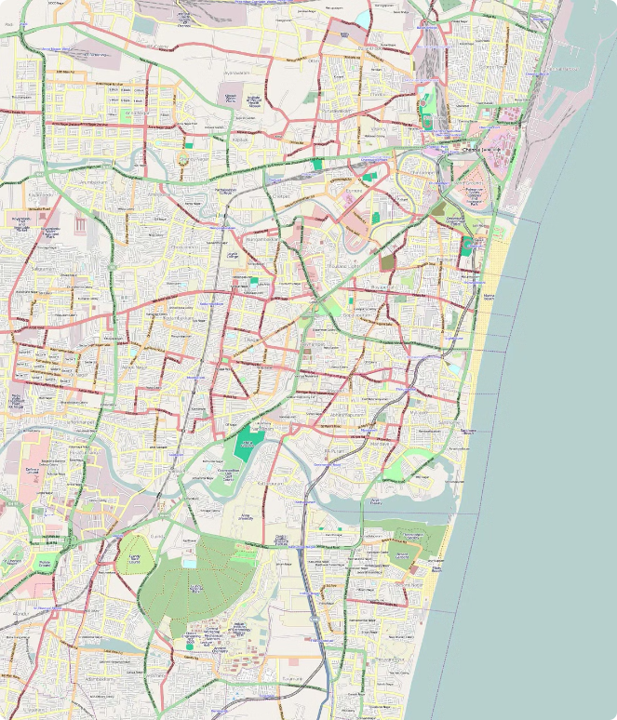



Setup Environment
To begin the simulation, the environment needs to be meticulously set up with accurate information about roads, toll zones, and vehicles.
Road Network Definition
The road network is defined using geospatial coordinates, delineating major roadways, intersections, and traffic patterns within the simulation area.
Toll Zone Placement
Toll zones are strategically positioned on the road network, with specific boundaries and associated toll rates. This information is crucial for toll calculations.
Vehicle Initialization
Vehicles are introduced into the simulation with pre-defined starting locations, destinations, and travel characteristics, such as speed and route preferences.

Slide 7


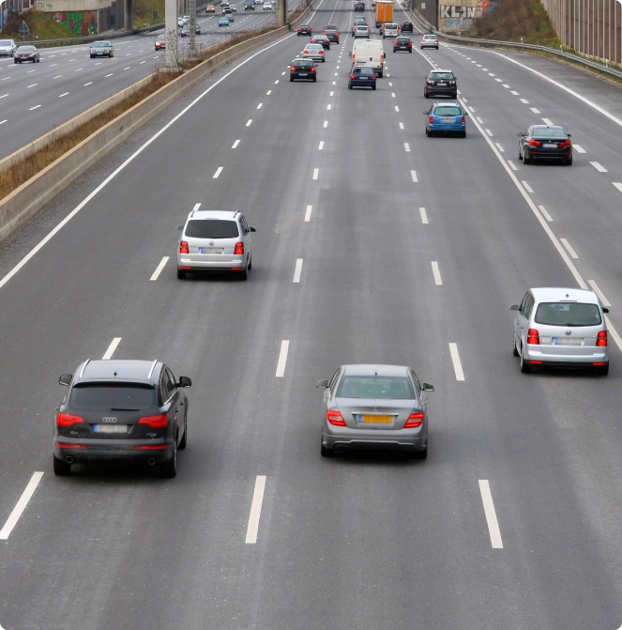




Simulate Vehicle Movement
The simulation engine utilizes SimPy, a powerful Python library for discrete-event simulation, to accurately model vehicle movements.
Movement Algorithm
The simulation uses a realistic movement algorithm, considering factors like speed limits, traffic congestion, and route choices, to simulate vehicle trajectories.
GPS Coordinate Update
The system continuously updates the GPS coordinates of each vehicle as it moves along the simulated road network, providing precise location data.
Route Generation
Vehicles are assigned routes between their starting points and destinations. The system can simulate both pre-determined and dynamically adjusted routes based on traffic conditions.

Slide 8

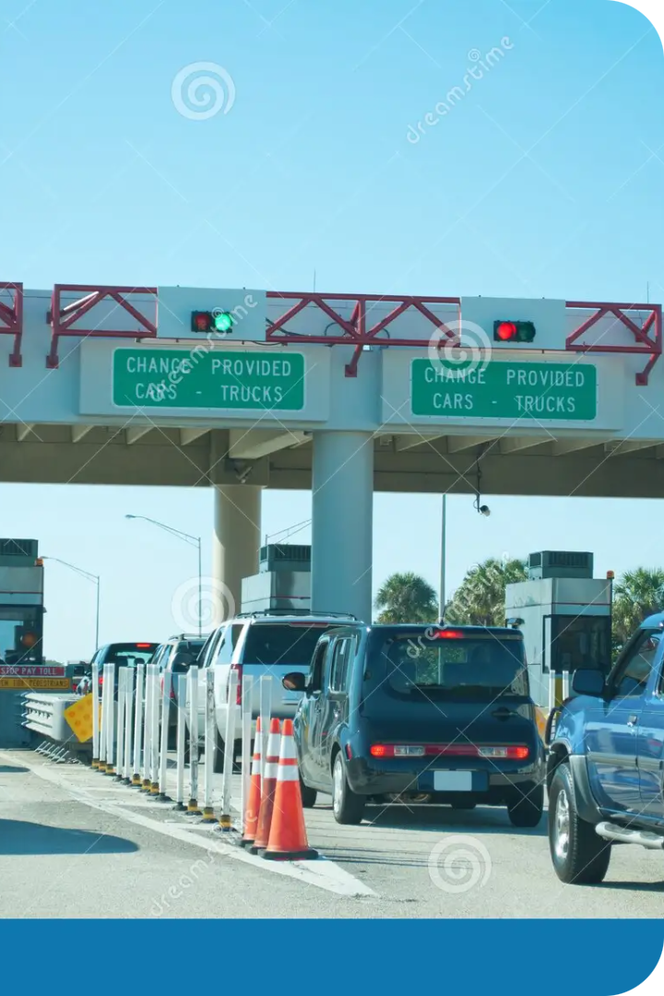
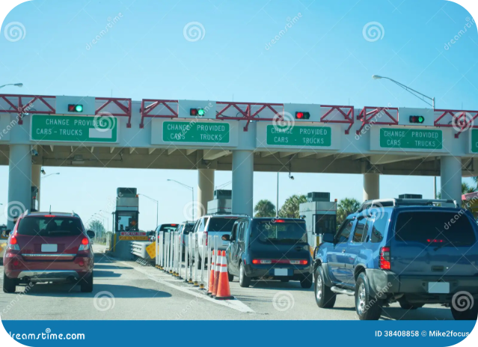
Calculate Toll Charges
Calculate toll charges based on distance traveled within toll zones, fixed fees for zone crossings, and dynamic pricing models.
Distance-Based
Toll charges based on the distance traveled within a toll zone.
Fixed Fee
A fixed toll charge for crossing a toll zone, regardless of distance.
Dynamic Pricing
Toll charges adjust based on factors like congestion and time of day.

Slide 9





Simulate Payments
Simulate payment processing, deducting toll charges from user accounts, and incorporating multiple payment vendors.
Credit Card Payment
E-Wallet Payment
Bank Account Payment
Simulate payments using credit cards, allowing users to pay for tolls directly.
Simulate payments using e-wallets, allowing users to pay for tolls using digital wallets.
Simulate payments using bank accounts, allowing users to pay for tolls through their bank accounts.

Slide 10
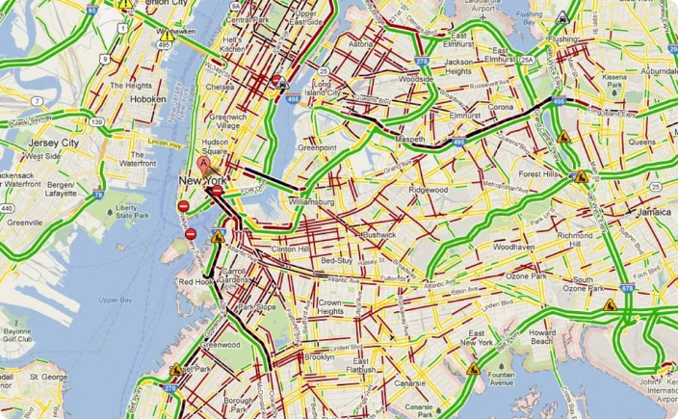
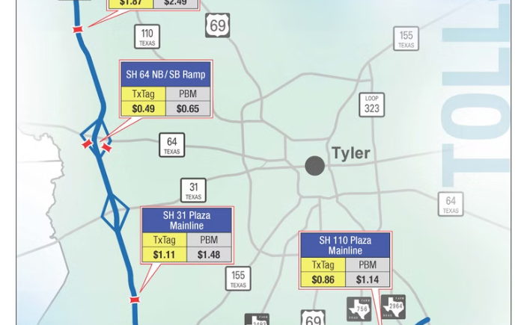
Visualization and Results
The simulation utilizes Folium, a powerful library for interactive web mapping, to visualize vehicle movements and toll zones in real-time, providing a clear understanding of the system's dynamics.
Vehicle Movement Visualization
Toll Zone Representation
Folium is used to create interactive maps that display the movements of vehicles in real-time, allowing for the analysis of traffic patterns and congestion points.
Toll zones are visually represented on the maps, clearly indicating the boundaries and associated toll rates, providing a comprehensive overview of the toll system.

Slide 11


Conclusion and Questions
GPS Toll-Based System Simulation provides a powerful tool for understanding the complexities of toll-based systems, facilitating the exploration of various optimization strategies. The simulation has successfully modeled vehicle movements, dynamic toll calculations, payment processing, and comprehensive analytics, offering valuable insights for transportation.
We invite you to explore the generated reports and visualizations, which provide detailed information on vehicle movements, toll collections, and system performance. Feel free to ask any questions you may have about the project, its implementation, or its potential applications.

Slide 12






